Slide 1


SOFTWARE Design & Analysis (Week-4)
Usama Musharaf
MS-CS (Software Engineering)
Lecturer (Department of Computer Science)
FAST-NUCES Peshawar

Slide 2
Agenda of week # 4
Design Concepts (Cont…)
Object Oriented Design Concepts.
Object Oriented Design with a Case Study.

Slide 3
EFFECTIVE MODULAR DESIGN

Slide 4
Functional Independence

Slide 5
Coupling
Coupling is a measure of independence of a module or component.
Loose coupling means that different system components have loose or less reliance upon each other.
Hence, changes in one component would have a limited affect on other components.

Slide 6
Coupling
High coupling causes problems
Change propagation- ripple effect
Difficulty in understanding
Difficult reuse

Slide 7
Cohesion
Cohesion is a measure of the degree to which the elements of the module are functionally related.
It is the degree to which all elements directed towards performing a single task are contained in the component.
Basically, cohesion is the internal glue that keeps the module together.
A good software design will have high cohesion

Slide 8
Coupling & Cohesion
A Software should be Lesly coupled and highly cohesive.
8

Slide 9
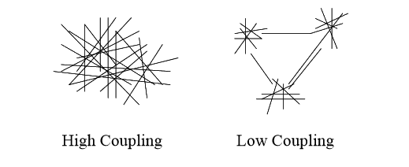
Coupling
9

Slide 10
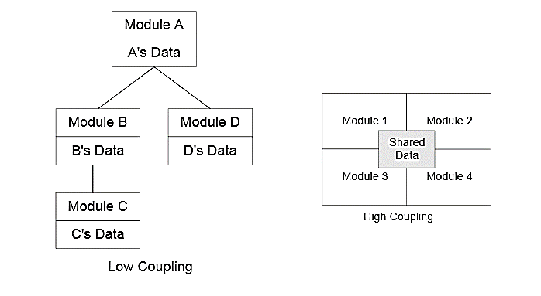
Coupling

Slide 11
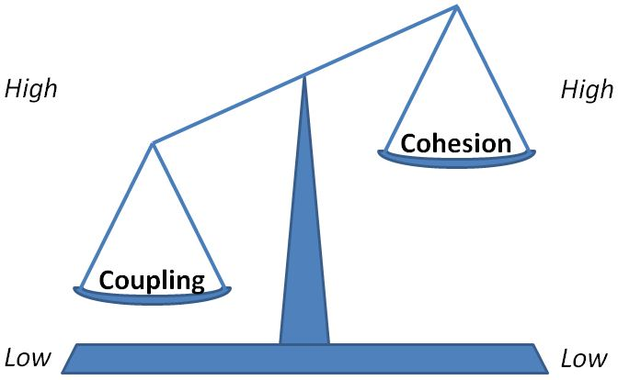
Relationship between Coupling and Cohesion

Slide 12
Content Coupling
This is highest level of coupling and occurs if there are two (or more) modules and if one refers to the ``inside'' - the ``internal'' or ``private'' part - of the other in some way.
Component A handles lookup data.
Component is handling the property of adding new customer when needed.
Component-A
Component-B

Slide 13
Content Coupling Example
When we are searching the customer data and customer is not found, lookup component adds customer by directly modifying the contents of the data structure containing customer data (new customer).
This is a very high level of coupling in which one component is directly modifying the content of another component and this is not wanted in any software design.
Component-A
Component-B

Slide 14
Content Coupling Example
Solution:
When customer not found, component calls the AddCustomer () method that is responsible for maintaining customer data rather than directly modifying data structure.

Slide 15
Common Coupling
Common coupling occurs when modules communicate using global data structures.
For example, programming allows the developer to declare a data element as external, enabling it to be accessed by all modules.
Common coupling is also known as “Global coupling”. We can say that two components share data using Global data structures.

Slide 16
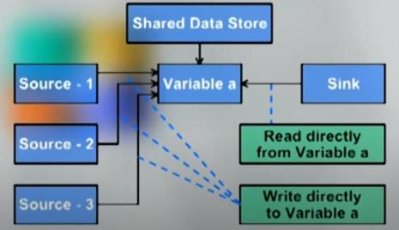
Common Coupling Example

Slide 17
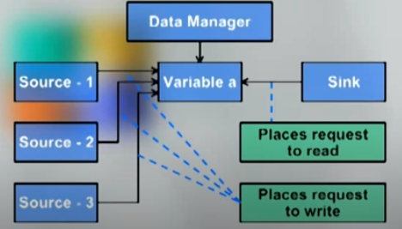
Common Coupling
Solution:

Slide 18
Object oriented design concepts

Slide 19
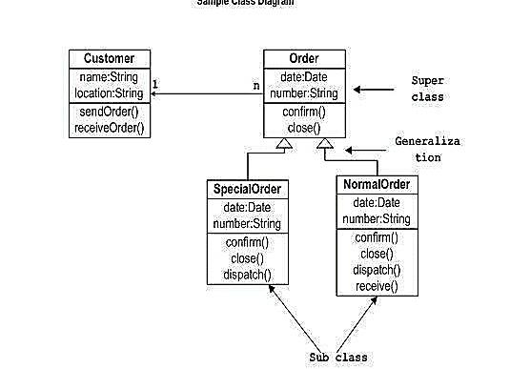
Class Diagram

Slide 20
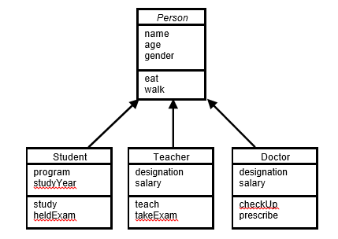
Inheritance
Advantages of Inheritance
Reuse
Less redundancy
Increased maintainability

Slide 21
Kinds of Association
There are two main types of association which are then further subdivided i.e.
Class Association
Object Association

Slide 22
Class Association
Class association is implemented in terms of Inheritance.
Inheritance implements generalization/specialization relationship between objects.
Inheritance is considered class association.

Slide 23
Object Association
It can be of one of the following types,
Simple Association
Composition
Aggregation

Slide 24
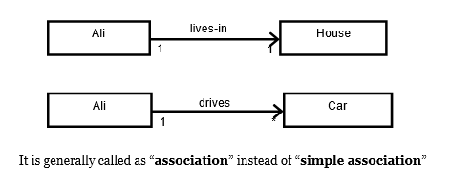
Simple Association

Slide 25
Kinds of Simple Association
Simple association can be categorized in two ways,
With respect to direction (navigation)
With respect to number of objects (cardinality)

Slide 26
Kinds of Simple Association w.r.t Navigation
With respect to navigation association has the following types,
One-way Association
Two-way Association

Slide 27
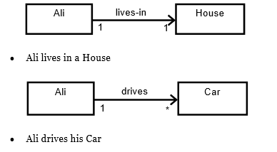
One-Way Association
In one-way association we can navigate along a single direction only, it is denoted by an arrow towards the server object.
Examples:

Slide 28
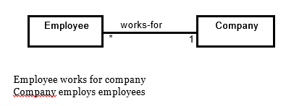
Two-Way Association
In two-way association we can navigate in both directions, it is denoted by a line between the associated objects.
Example:

Slide 29
Kinds of Simple Association w.r.t Cardinality
With respect to cardinality association has the following types,
Binary Association
Ternary Association
N-ary Association

Slide 30
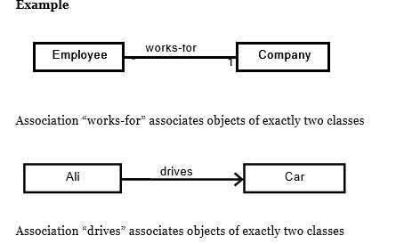
Binary Association
It associates objects of exactly two classes; it is denoted by a line, or an arrow between the associated objects.

Slide 31
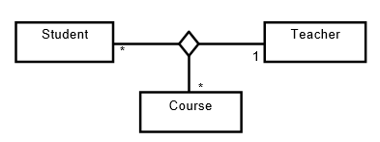
Ternary Association
It associates objects of exactly three classes; it is denoted by a diamond with lines connected to associated objects.
Example:
Objects of exactly three classes are associated

Slide 32
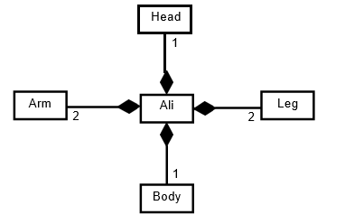
Composition
An object may be composed of other smaller objects, the relationship between the “part” objects and the “whole” object is known as Composition.
Composition is represented by a line with a filled-diamond head towards the composer object.

Slide 33
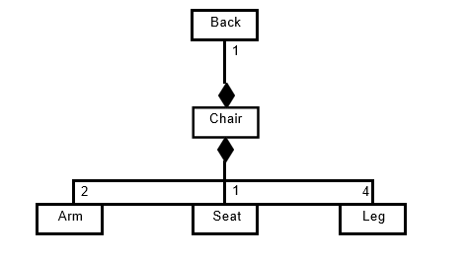
Composition
Composition of chair:

Slide 34
Composition
Composition is stronger relationship because
Composed object becomes a part of the composer.
Composed object can’t exist independently.
Example I
Ali is made up of different body parts They can’t exist independent of Ali
Example II
Chair’s body is made up of different parts They can’t exist independently

Slide 35
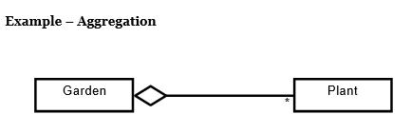
Aggregation
An object may contain a collection (aggregate) of other objects, the relationship between the container and the contained object is called aggregation,
Aggregation is represented by a line with unfilled-diamond head towards the container.

Slide 36
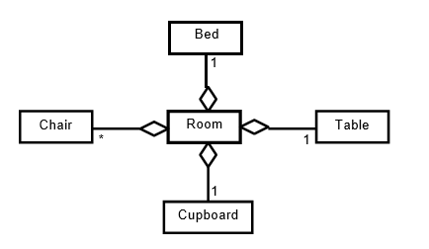
Aggregation

Slide 37
Aggregation
Aggregation is weaker relationship because
Aggregate object is not a part of the container
Aggregate object can exist independently
Example I
Furniture is not an intrinsic part of room
Furniture can be shifted to another room, and so can exist independent of a particular room
Example II
A plant is not an intrinsic part of a garden
It can be planted in some other garden, and so can exist independent of a particular garden

Slide 38
Polymorphism
It is also essential component of object oriented modeling (paradigm).
In general, polymorphism refers to existence of different forms of a single entity.
For example, both Diamond and Coal are different forms of Carbon.
In OO model, polymorphism means that different objects can behave in different ways for the same message (stimulus).

Slide 39
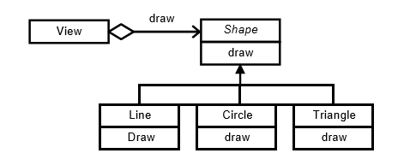
Polymorphism

Slide 40
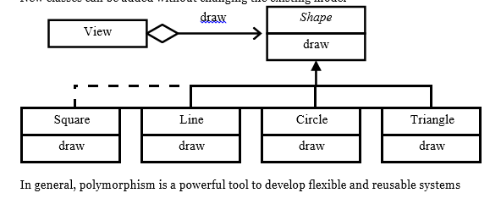
Polymorphism Advantages
Messages can be interpreted in different ways depending upon the receiver class.
New classes can be added without changing the existing model.

Slide 41
object oriented design with A case study

Slide 42
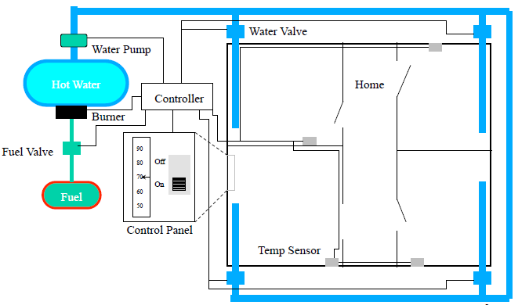
The Home Heating System

Slide 43
Home Heating Requirements
The purpose of the software for the Home Heating System is to control the heating system that heats the rooms of a house. The software shall maintain the temperature of each room within a specified range by controlling the heat flow to individual rooms.

Slide 44
Home Heating Requirements
The software shall control the heat in each room
The room shall be heated when the temperature is 2F below desired temp
The room shall no longer be heated when the temperature is 2F above desired temp
The flow of heat to each room shall be individually controlled by opening and closing its water valve
The valve shall be open when the room needs heat and closed otherwise
The user shall set the desired temperature on the thermostat
The operator shall be able to turn the heating system on and off

Slide 45
Home Heating Requirements
The furnace must not run when the system is off
When the furnace is not running and a room needs heat, the software shall turn the furnace on
To turn the furnace on the software shall follow these steps
– open the fuel valve
– turn the burner on
The software shall turn the furnace off when heat is no longer needed in any room
To turn the furnace off the software shall follow these steps
– close fuel valve

Slide 46
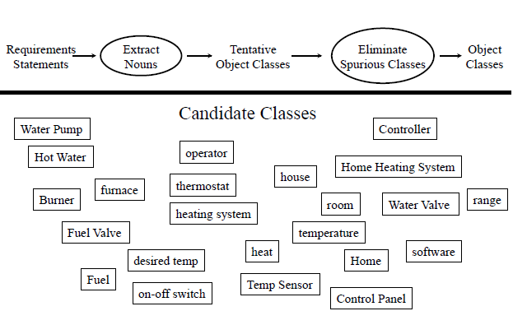
Identify Object Classes

Slide 47
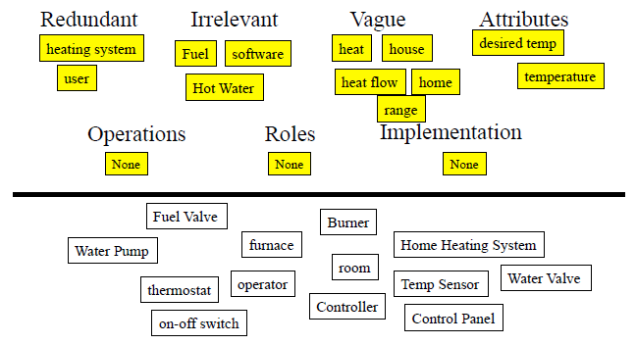
Elimination

Slide 48
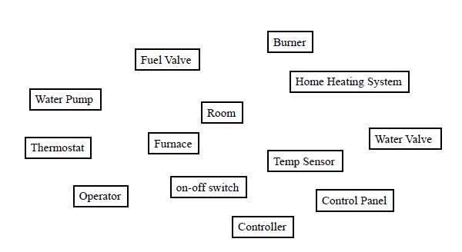
After Elimination

Slide 49
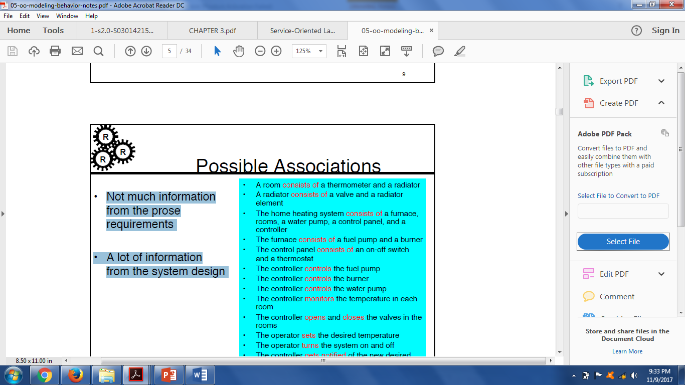
Possible Associations

Slide 50
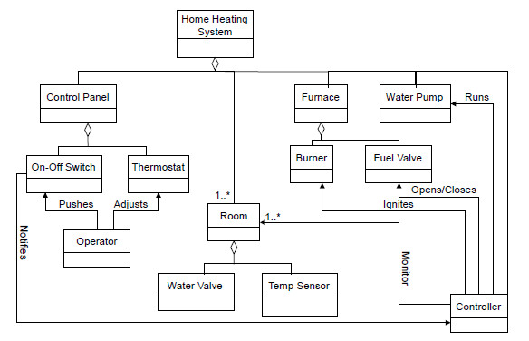
Object Model

Slide 51
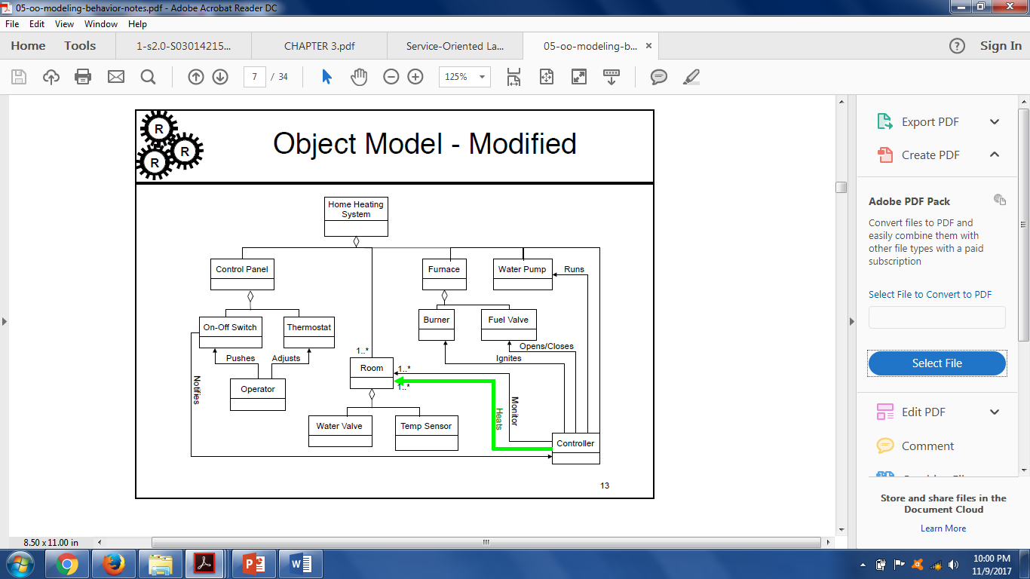
Object Model - Modified

Slide 52
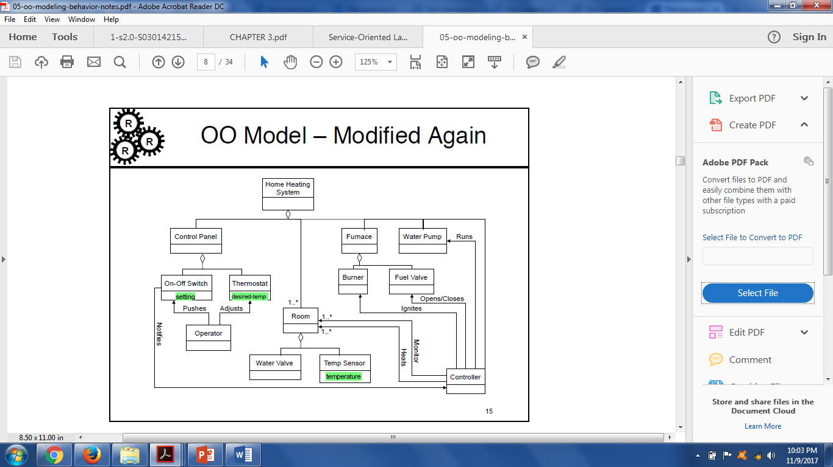
Object Model: Attributes

Slide 53
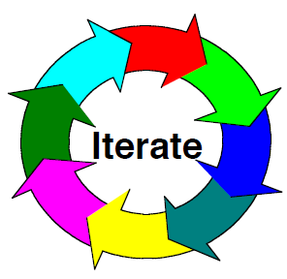
Iterate the Model
Keep on doing this until you, your customer, and your engineers are happy with the model

Slide 54
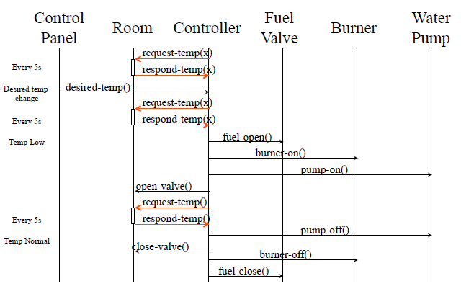
Sequence Diagram

Slide 55
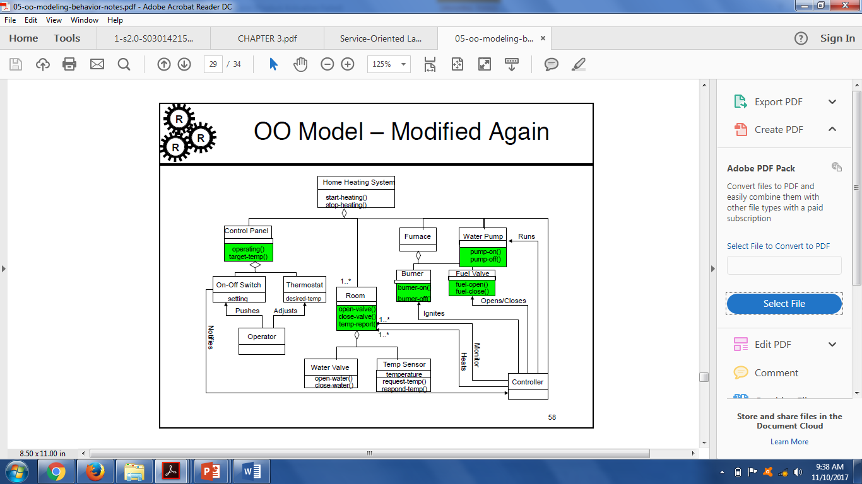
OO Model – Modified Again!

Slide 56
Iterate the Model
Keep on doing this until you, your customer, and your engineers are happy with the model

Slide 57
HAVE A GOOD DAY!

